Slide 1
LOGICAL REASONING
RANKING ARRANGEMENT

Slide 2
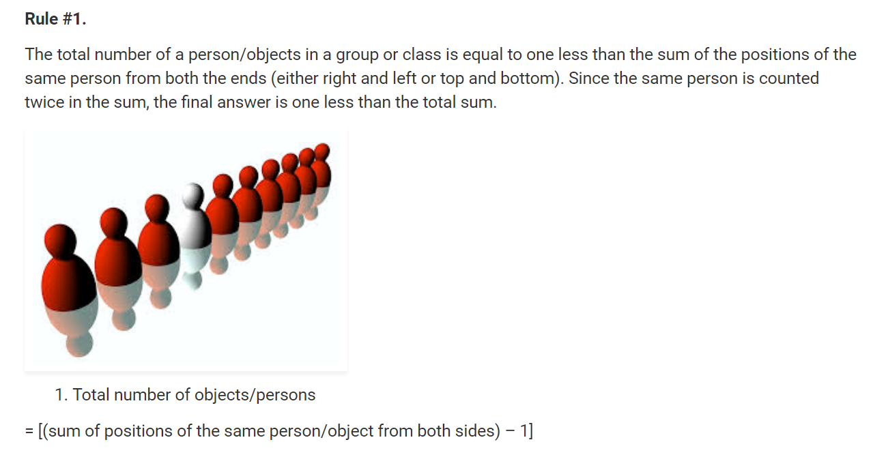
LOGICAL REASONING

Slide 3
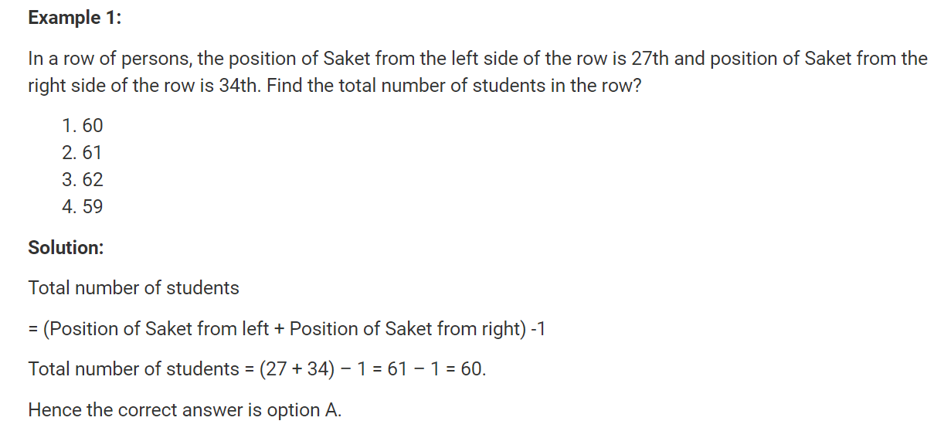
LOGICAL REASONING

Slide 4
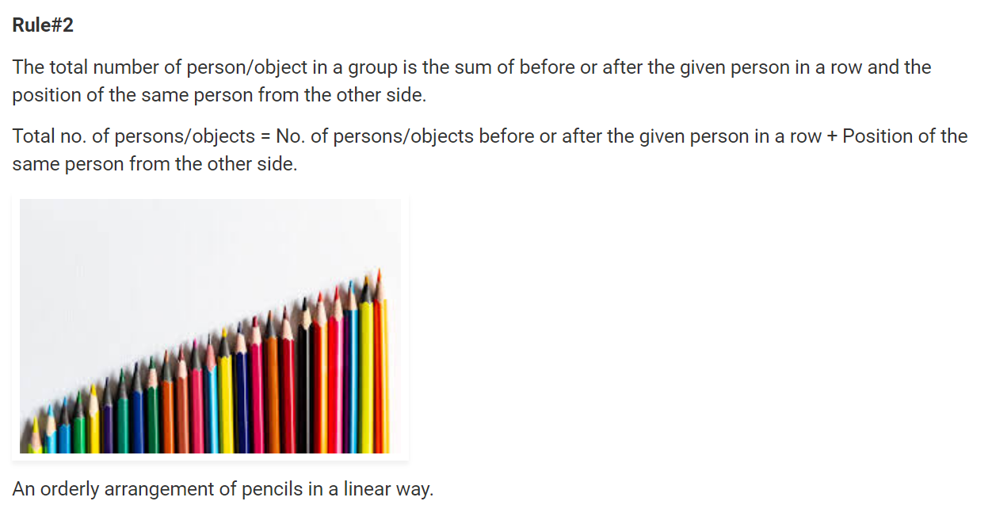
LOGICAL REASONING

Slide 5
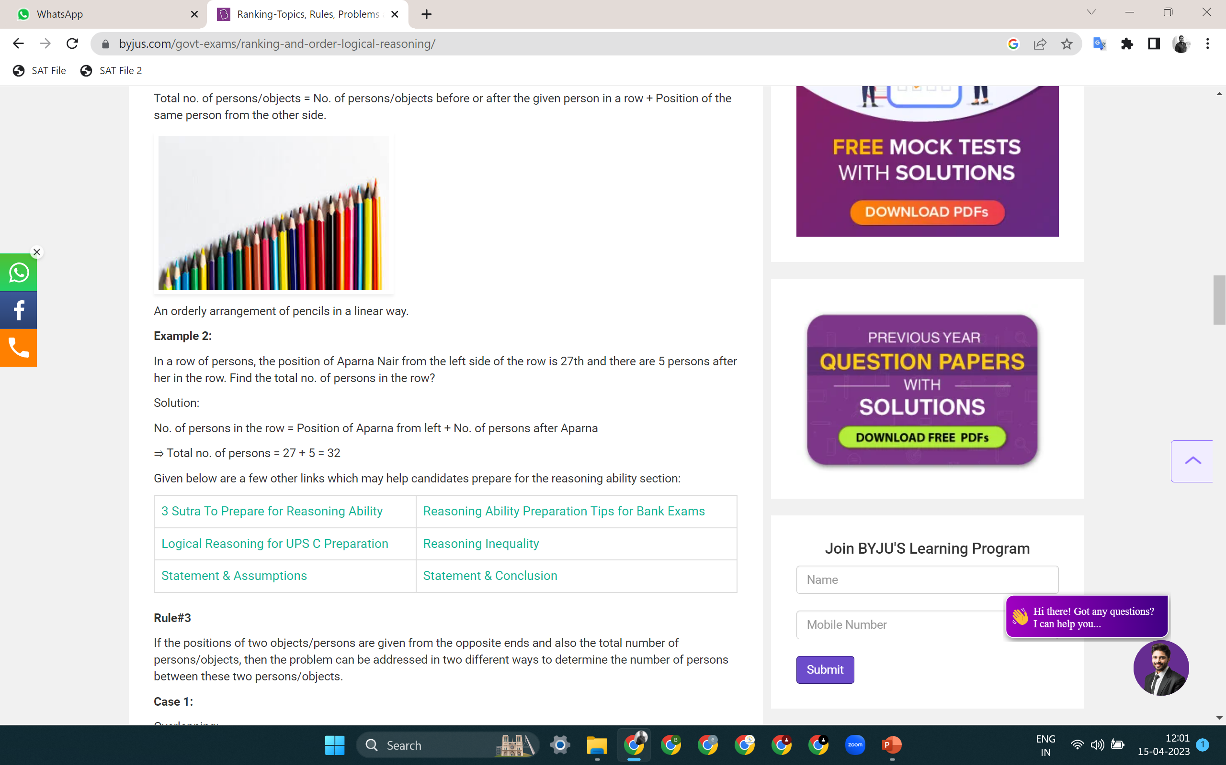
LOGICAL REASONING

Slide 6
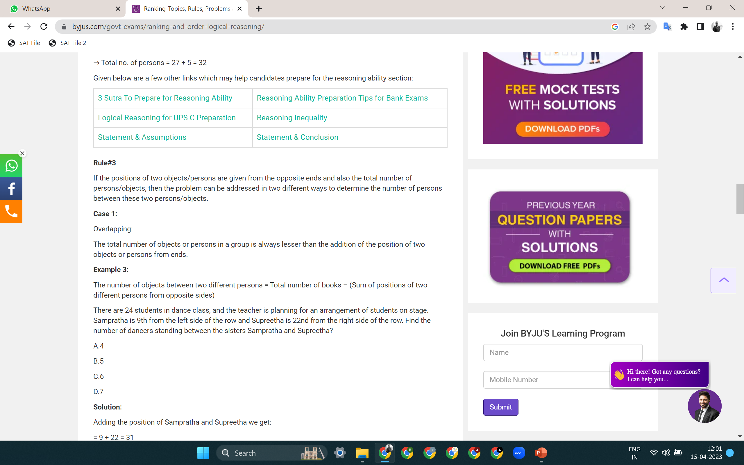
LOGICAL REASONING

Slide 7
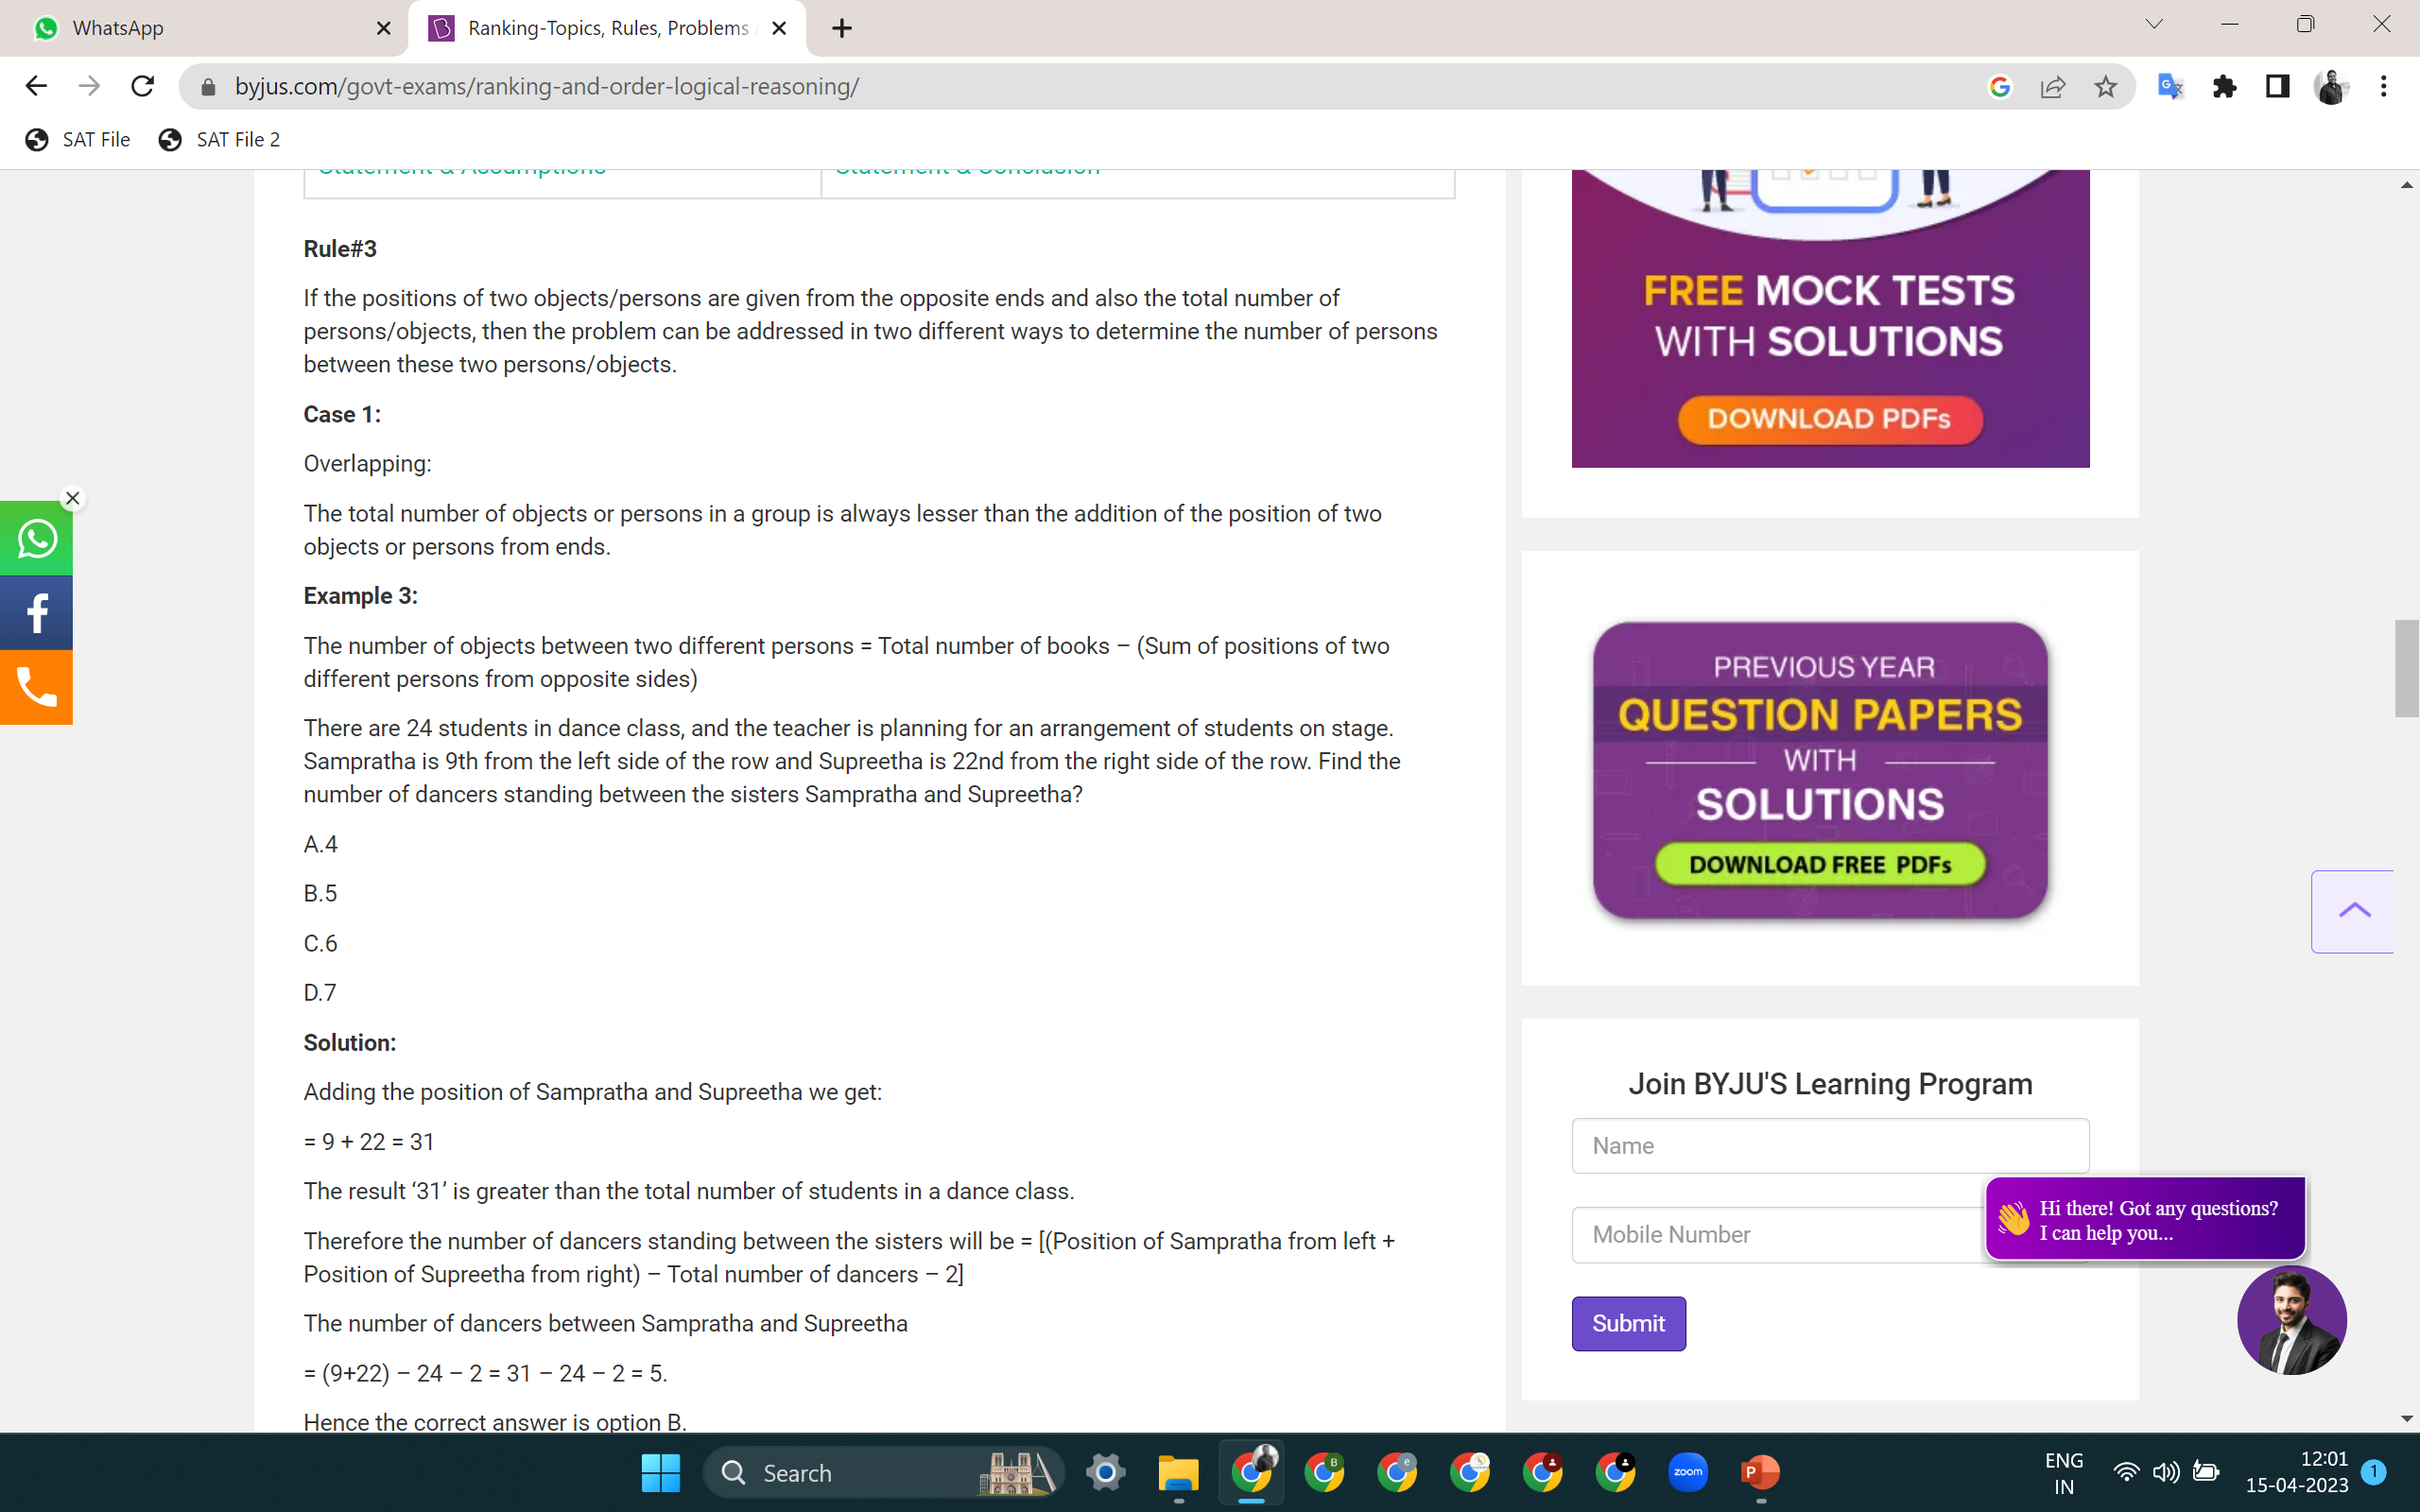
LOGICAL REASONING

Slide 8
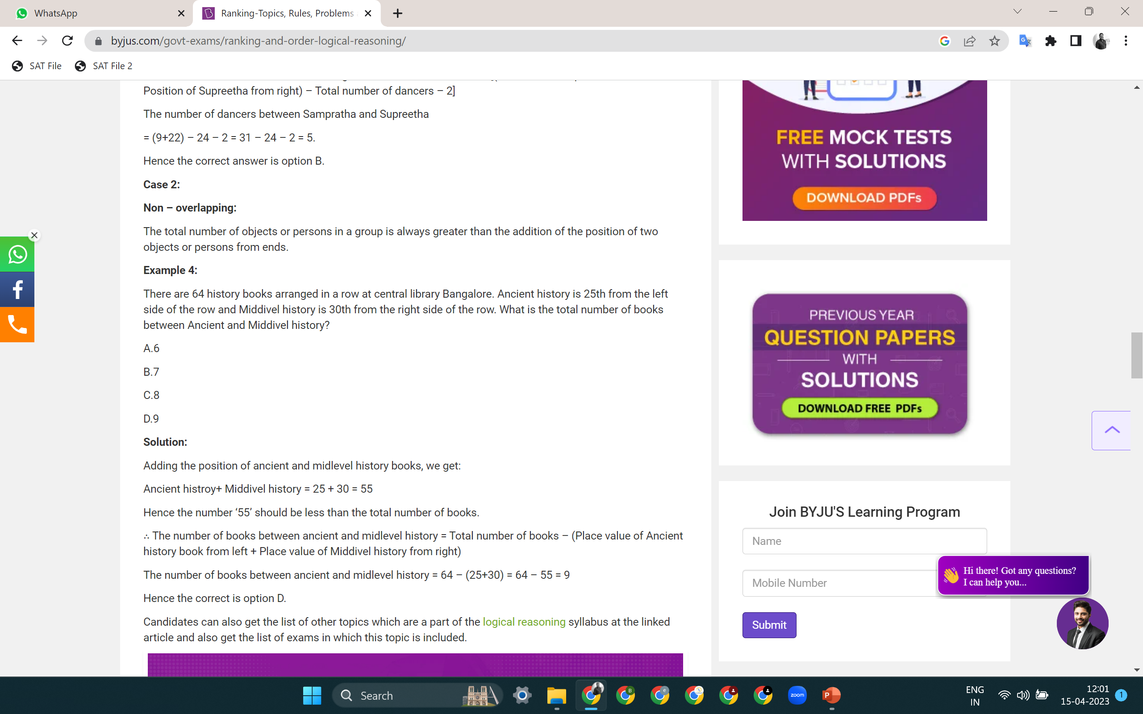
LOGICAL REASONING

Slide 9
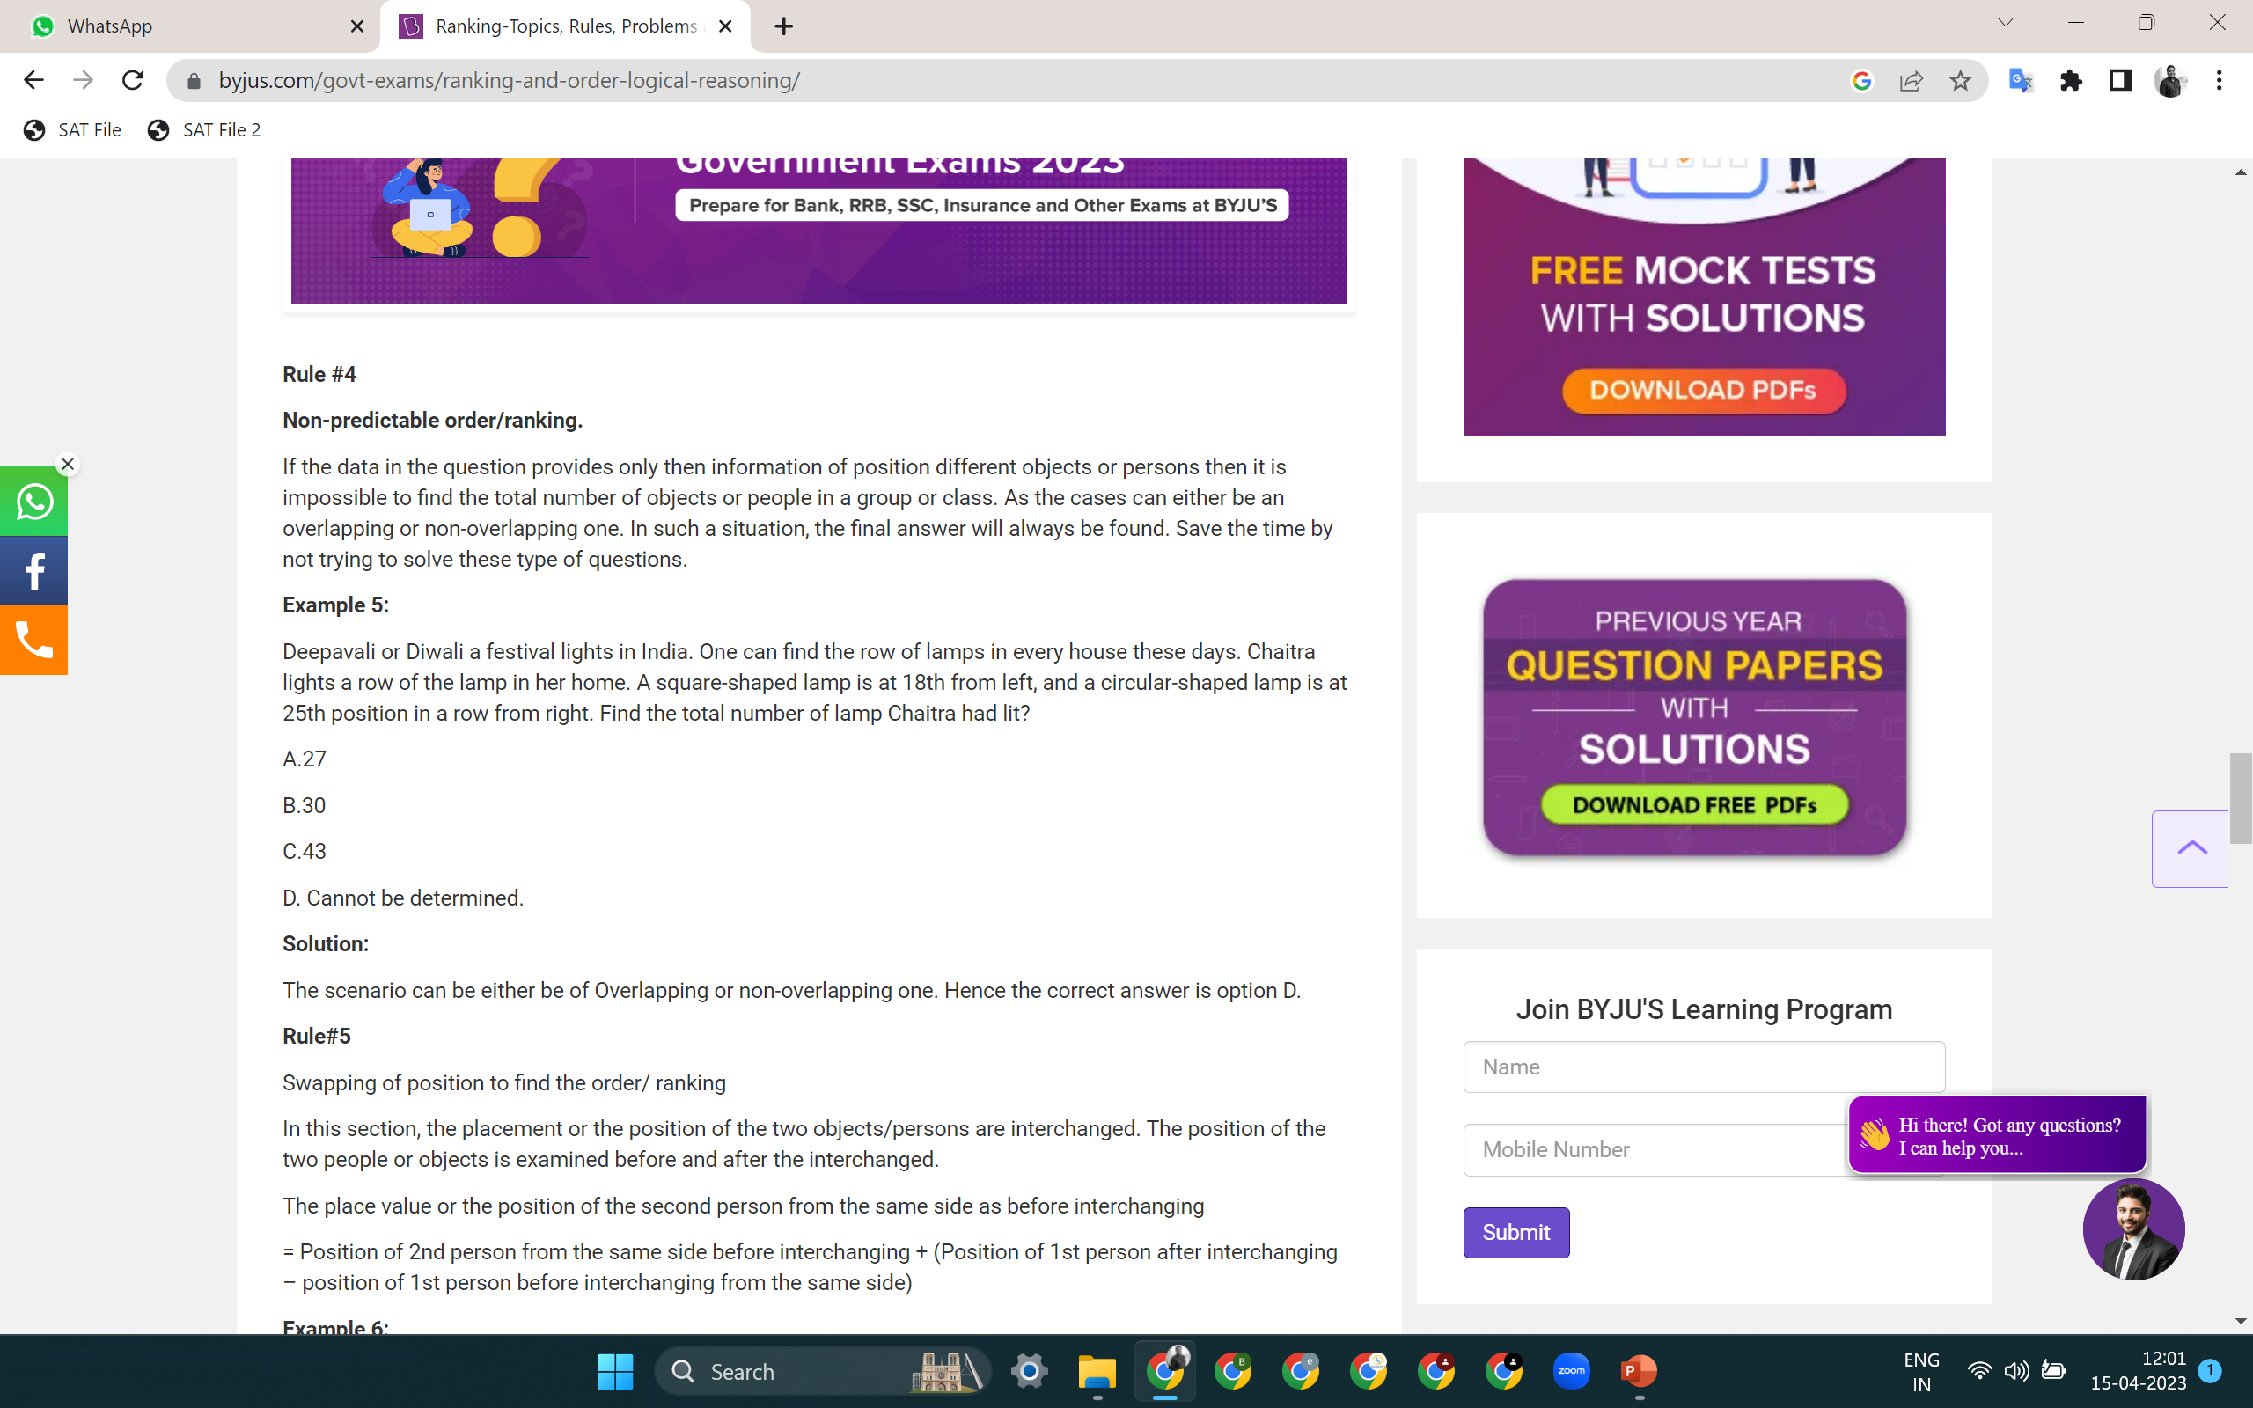
LOGICAL REASONING

Slide 10
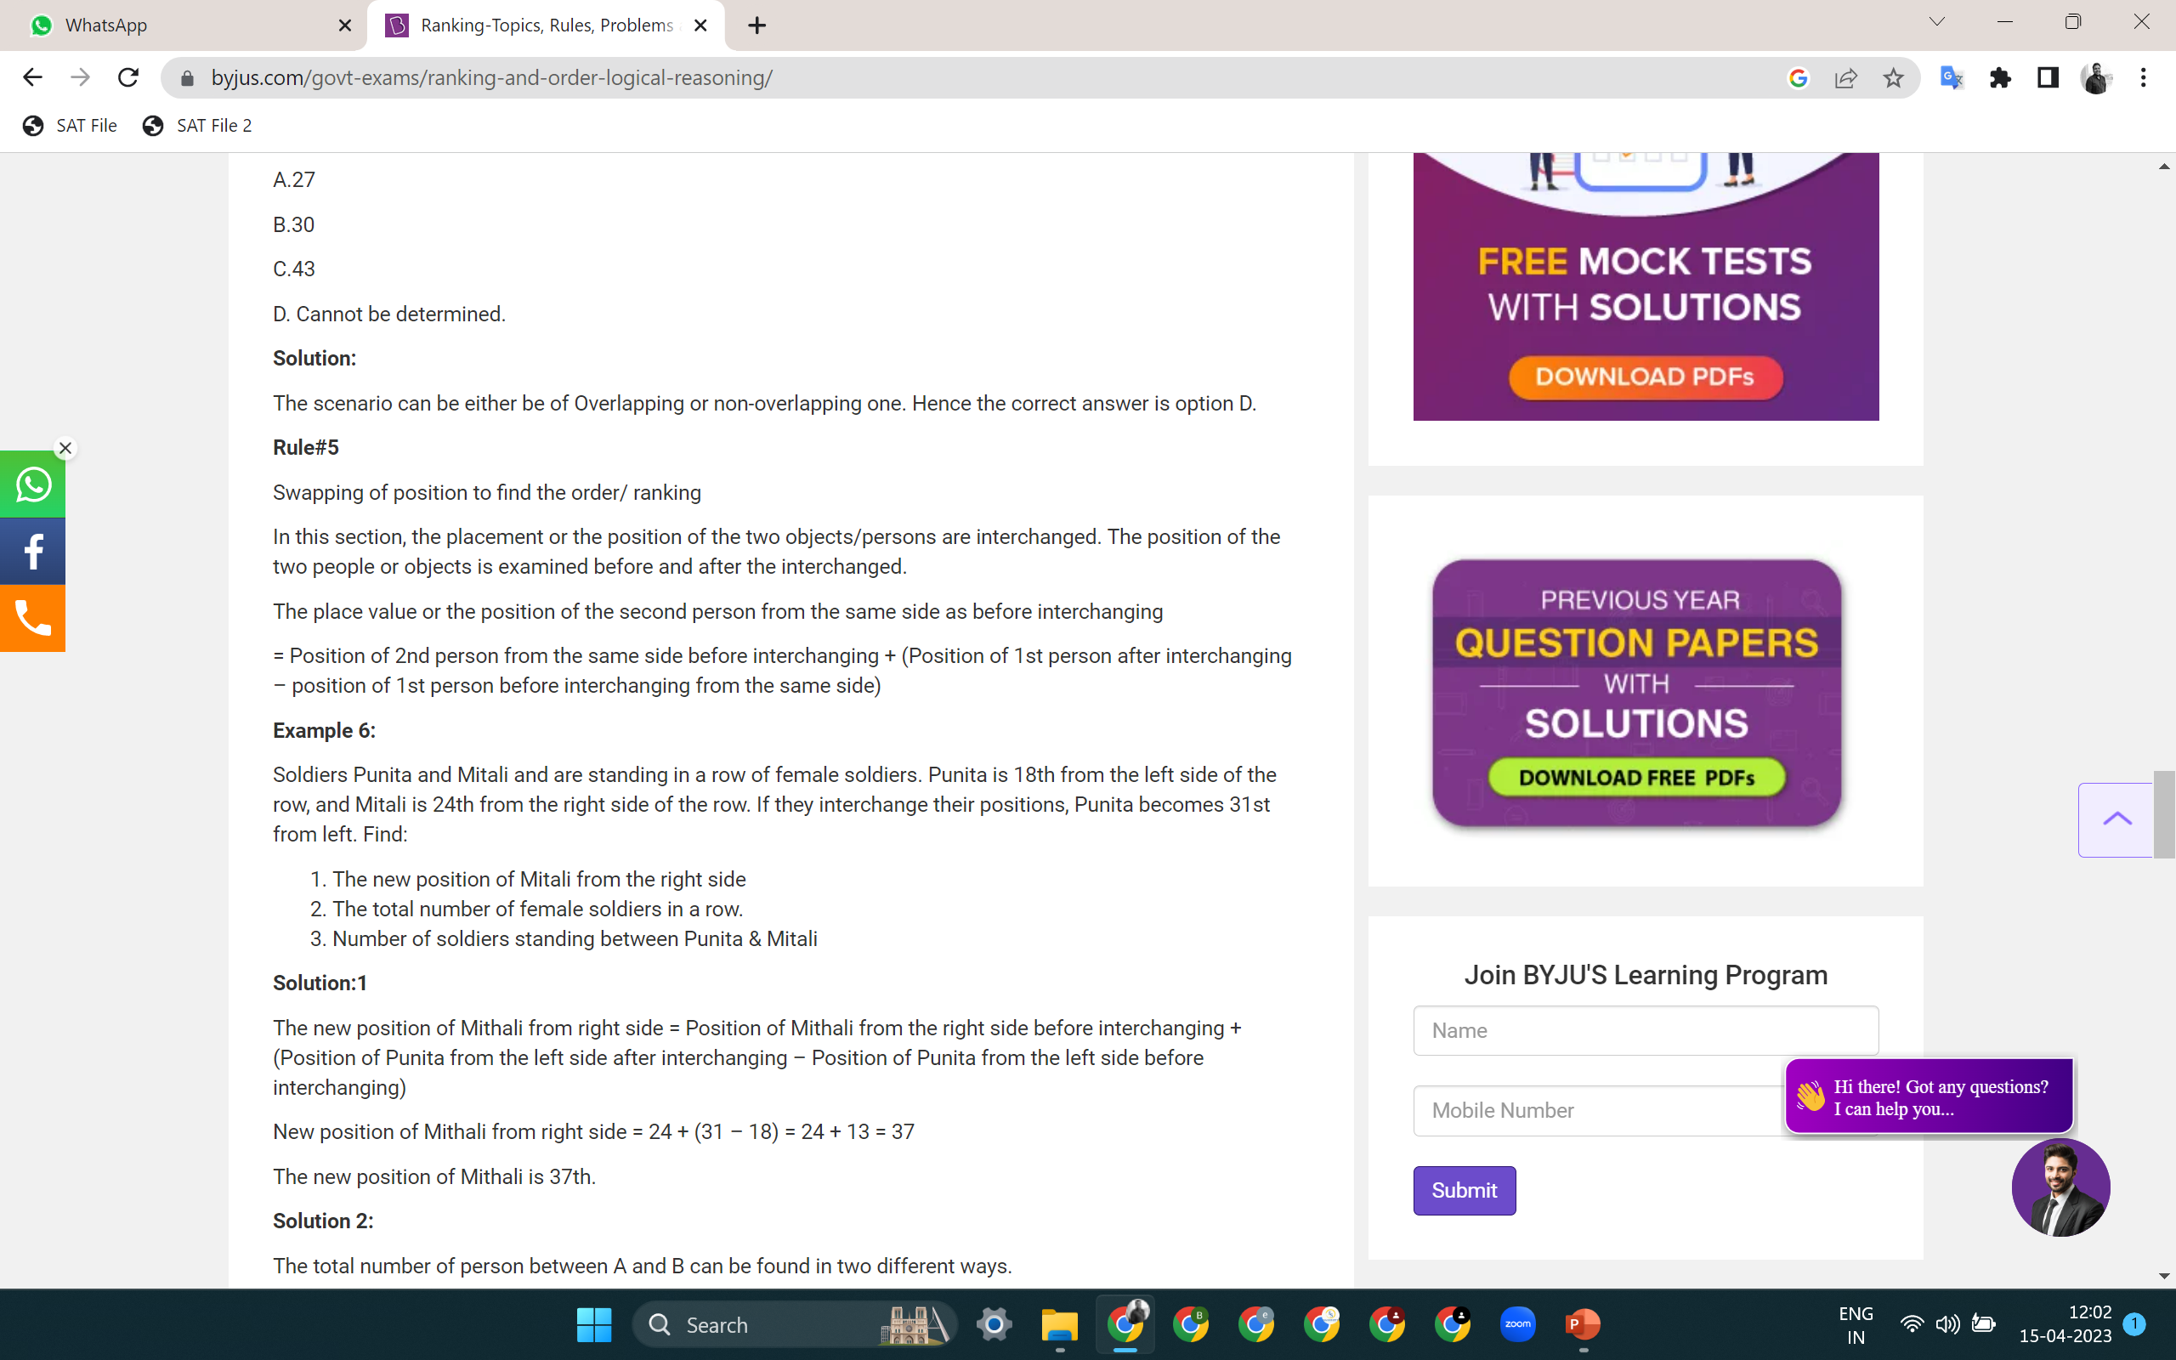
LOGICAL REASONING

Slide 11

LOGICAL REASONING

Slide 12
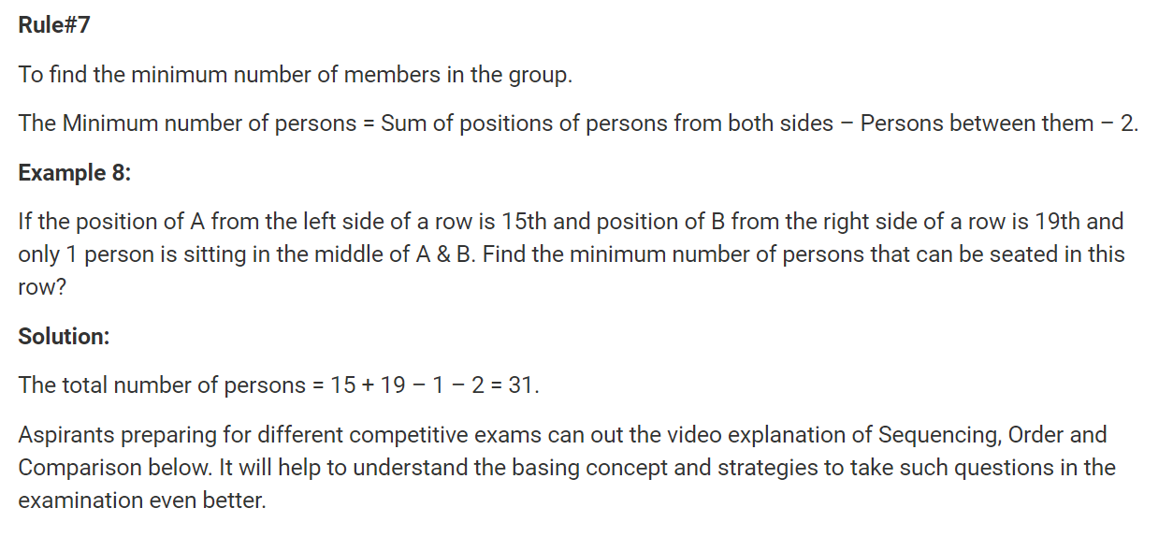
LOGICAL REASONING

Slide 13
LOGICAL REASONING
RANKING ARRANGEMENT
Q 1. In a Queue Ram is 11th from top and 22th from bottom then total no. of students are?
(a) 34 (b) 33 (c) 32 (d) 31

Slide 14
LOGICAL REASONING
RANKING ARRANGEMENT
Q 1. In a Queue Ram is 11th from top and 22th from bottom then total no. of students are?
(a) 34 (b) 33 (c) 32 (d) 31

Slide 15
LOGICAL REASONING
RANKING ARRANGEMENT
Q 2. Amar ranked sixteenth from the top and twentyninth from the bottom among those who passed an examination. Six boys did not participate in the competition and five failed in it. How many boys were there in the class?
(a) 40 (b) 44 (c) 50 (d) 55

Slide 16
LOGICAL REASONING
RANKING ARRANGEMENT
Q 2. Amar ranked sixteenth from the top and twentyninth from the bottom among those who passed an examination. Six boys did not participate in the competition and five failed in it. How many boys were there in the class?
(a) 40 (b) 44 (c) 50 (d) 55

Slide 17
LOGICAL REASONING
RANKING ARRANGEMENT
Q 3. If Vikash finds that he is twelfth from the right and fourth from the left, how many boys should be added to the queue so that there are 28 boys in the line?
(a) 12 (b) 13 (c) 14 (d) 20

Slide 18
LOGICAL REASONING
RANKING ARRANGEMENT
Q 3. If Vikash finds that he is twelfth from the right and fourth from the left, how many boys should be added to the queue so that there are 28 boys in the line?
(a) 12 (b) 13 (c) 14 (d) 20

Slide 19
LOGICAL REASONING
RANKING ARRANGEMENT
Q 4. In a row of boys, Jeevan is seventh from the start and eleventh from the end. In another row of boys, Vikas is tenth from the start and twelfth from the end. Hoew many boys are there in both the rows together?
(a) 36 (b) 37 (c) 39 (d) none of these

Slide 20
LOGICAL REASONING
RANKING ARRANGEMENT
Q 4. In a row of boys, Jeevan is seventh from the start and eleventh from the end. In another row of boys, Vikas is tenth from the start and twelfth from the end. Hoew many boys are there in both the rows together?
(a) 36 (b) 37 (c) 39 (d) none of these

Slide 21
LOGICAL REASONING
RANKING ARRANGEMENT
Q 5. In a row of 57 boys mohan is 21th from left end then what is his position from right end.
(a) 36 (b) 37 (c) 35 (d) 34

Slide 22
LOGICAL REASONING
RANKING ARRANGEMENT
Q 5. In a row of 57 boys mohan is 21th from left end then what is his position from right end.
(a) 36 (b) 37 (c) 35 (d) 34

Slide 23
LOGICAL REASONING
RANKING ARRANGEMENT
Q 6. In a queue of 81 girls Vibha’s position from end in 30th. What is Vibha’s position from starting.
(a) 51 (b) 52 (c) 50 (d) 60

Slide 24
LOGICAL REASONING
RANKING ARRANGEMENT
Q 6. In a queue of 81 girls Vibha’s position from end in 30th. What is Vibha’s position from starting.
(a) 51 (b) 52 (c) 50 (d) 60

Slide 25
LOGICAL REASONING
RANKING ARRANGEMENT
Q 7. In a class of 48 students Mona’s position is 12th. If two new students join the class (they are more intelligent to Mona in study). Then what is Mona’s position from opposite side.
(a)35 (b) 34 (c) 36 (d) 37

Slide 26
LOGICAL REASONING
RANKING ARRANGEMENT
Q 7. In a class of 48 students Mona’s position is 12th. If two new students join the class (they are more intelligent to Mona in study). Then what is Mona’s position from opposite side.
(a)35 (b) 34 (c) 36 (d) 37

Slide 27
LOGICAL REASONING
RANKING ARRANGEMENT
Q 8. In a row of boys, A is thirteenth from the left and D is seventeenth from the right. If in this row A is eleventh from the right then what is the position of D from the left?
(a) 6th (b) 7th (c) 10th (d) 12th

Slide 28
LOGICAL REASONING
RANKING ARRANGEMENT
Q 8. In a row of boys, A is thirteenth from the left and D is seventeenth from the right. If in this row A is eleventh from the right then what is the position of D from the left?
(a) 6th (b) 7th (c) 10th (d) 12th

Slide 29
LOGICAL REASONING
RANKING ARRANGEMENT
Q 9. Mohan is thirteenth from the left end in a row of children. Praveen is twelth from the right end and eighteenth from the left end. How many children are towards the right of mohan in that row?
(a) 16 (b) 18 (c) 17 (d) Can’t be determined

Slide 30
LOGICAL REASONING
RANKING ARRANGEMENT
Q 9. Mohan is thirteenth from the left end in a row of children. Praveen is twelth from the right end and eighteenth from the left end. How many children are towards the right of mohan in that row?
(a) 16 (b) 18 (c) 17 (d) Can’t be determined

Slide 31
LOGICAL REASONING
RANKING ARRANGEMENT
Q 10. Raman is fifteenth from the front in a column of boys. There were thrice as many behind him as there were in front. How many boys are there between Raman and the seventh boy from the end of the column?
(a) 33 (b) 34 (c) 35 (d) Data inadequate

Slide 32
LOGICAL REASONING
RANKING ARRANGEMENT
Q 10. Raman is fifteenth from the front in a column of boys. There were thrice as many behind him as there were in front. How many boys are there between Raman and the seventh boy from the end of the column?
(a) 33 (b) 34 (c) 35 (d) Data inadequate

Slide 33
LOGICAL REASONING
RANKING ARRANGEMENT
Q 11. In a row of girls, there are 16 girls between Priya and Natasha. priya is thirty-second from the left end of fthe row. If Priya is nearer than Natasha to the right end of the row, then how far away is natasha from the left end of the row?
(a) Data inadequate (b) 14th (c) 15th (d) 16th

Slide 34
LOGICAL REASONING
RANKING ARRANGEMENT
Q 11. In a row of girls, there are 16 girls between Priya and Natasha. priya is thirty-second from the left end of fthe row. If Priya is nearer than Natasha to the right end of the row, then how far away is natasha from the left end of the row?
(a) Data inadequate (b) 14th (c) 15th (d) 16th

Slide 35
LOGICAL REASONING
RANKING ARRANGEMENT
Q 12. In a row of boys , if A who is tenth from the left and B who is ninth from the right interchange their positions, A becomes fifteenth from the left. How many boys are there in the row?
(a) 23 (b) 27 (c) 28 (d) 31

Slide 36
LOGICAL REASONING
RANKING ARRANGEMENT
Q 12. In a row of boys , if A who is tenth from the left and B who is ninth from the right interchange their positions, A becomes fifteenth from the left. How many boys are there in the row?
(a) 23 (b) 27 (c) 28 (d) 31

Slide 37
LOGICAL REASONING
RANKING ARRANGEMENT
Q 13. Students line up in a queue in which Ashish stands fifiteenth from the left and Sachin is seventh from the right. if they interchange their places, Sachin would be fifteenth from the right. How many srudents are there in the queue?
(a) 21 (B) 22 (c) 29 (d) none of these

Slide 38
LOGICAL REASONING
RANKING ARRANGEMENT
Q 13. Students line up in a queue in which Ashish stands fifiteenth from the left and Sachin is seventh from the right. if they interchange their places, Sachin would be fifteenth from the right. How many srudents are there in the queue?
(a) 21 (B) 22 (c) 29 (d) none of these

Slide 39
LOGICAL REASONING
RANKING ARRANGEMENT
Q 14. In a row of children, Deepti is ninth from the left and kashish is thirteenth from the right. They exchange their positions and then Deepti becomes seventeenth from the left. Find the new position of Kashish from the right end of the row.
(a) 20 (b) 21 (c) 27 (d) 31

Slide 40
LOGICAL REASONING
RANKING ARRANGEMENT
Q 14. In a row of children, Deepti is ninth from the left and kashish is thirteenth from the right. They exchange their positions and then Deepti becomes seventeenth from the left. Find the new position of Kashish from the right end of the row.
(a) 20 (b) 21 (c) 27 (d) 31

Slide 41
LOGICAL REASONING
RANKING ARRANGEMENT
Q 15. In a row of girls, kamala is tenth from the left and Vimla is twelth from the right. when they exchange their places, Kamala is sixteenth from the left. What is the new position of Vimala from the right?
(a) 28th (b) 22nd (c) 26th (d) 18th

Slide 42
LOGICAL REASONING
RANKING ARRANGEMENT
Q 15. In a row of girls, kamala is tenth from the left and Vimla is twelth from the right. when they exchange their places, Kamala is sixteenth from the left. What is the new position of Vimala from the right?
(a) 28th (b) 22nd (c) 26th (d) 18th

Slide 43
LOGICAL REASONING
RANKING ARRANGEMENT
Q 16. In a queue of boy shailesh is 20th from starting and Anish is 15th from end. There are 14 person between them. What is the maximum number of person in queue?
(a) 44 (b) 43 (c) 49 (d) 45

Slide 44
LOGICAL REASONING
RANKING ARRANGEMENT
Q 16. In a queue of boy shailesh is 20th from starting and Anish is 15th from end. There are 14 person between them. What is the maximum number of person in queue?
(a) 44 (b) 43 (c) 49 (d) 45

Slide 45
LOGICAL REASONING
RANKING ARRANGEMENT
Q 17. In a row of girls Seema is 20th from starting and Rina is 25th from end. There are 8 girls between them. Total number of girls are?
(a) 35 (b) 53 (c) 55 (d) either 35 or 53

Slide 46
LOGICAL REASONING
RANKING ARRANGEMENT
Q 17. In a row of girls Seema is 20th from starting and Rina is 25th from end. There are 8 girls between them. Total number of girls are?
(a) 35 (b) 53 (c) 55 (d) either 35 or 53

Slide 47
LOGICAL REASONING
RANKING ARRANGEMENT
Q 18. In a queue of 20 boys, D is fourteenth from the front and F is ninth from the bottom. How many boy are there between D and F?
(a) 2 (b) 3 (c) 1 (d) Data inadequate

Slide 48
LOGICAL REASONING
RANKING ARRANGEMENT
Q 18. In a queue of 20 boys, D is fourteenth from the front and F is ninth from the bottom. How many boy are there between D and F?
(a) 2 (b) 3 (c) 1 (d) Data inadequate

Slide 49
LOGICAL REASONING
RANKING ARRANGEMENT
Q 19. In a row of boys Madan is twentieth from the left end twelfth from the right end Pratap is fifteenth from right end in that row. How many boys are there between Madan and Pratap?
(a) 4 (b) 2 (c) 3 (d) 5

Slide 50
LOGICAL REASONING
RANKING ARRANGEMENT
Q 19. In a row of boys Madan is twentieth from the left end twelfth from the right end Pratap is fifteenth from right end in that row. How many boys are there between Madan and Pratap?
(a) 4 (b) 2 (c) 3 (d) 5

Slide 51
LOGICAL REASONING
RANKING ARRANGEMENT
Q 20. In a row of students, Ramesh in 12th from the left and Kashi is 17th from the right. When Ramesh and Kashi interchange their positions Kashi becomes 27th from the right. How many students are there between Kashi and Ramesh?
(a) 9 (b) 12 (c) 7 (d) 10

Slide 52
LOGICAL REASONING
RANKING ARRANGEMENT
Q 20. In a row of students, Ramesh in 12th from the left and Kashi is 17th from the right. When Ramesh and Kashi interchange their positions Kashi becomes 27th from the right. How many students are there between Kashi and Ramesh?
(a) 9 (b) 12 (c) 7 (d) 10

Slide 53
LOGICAL REASONING
RANKING ARRANGEMENT
Q 21. In a class of 60, Where girls are twice to of boys, Kamal ranked sixteenth from top. If there are 9 girls ahead of Kamal, how many boys are after him in rank?
(a) 13 (b) 7 (c) 12 (d) 23

Slide 54
LOGICAL REASONING
RANKING ARRANGEMENT
Q 21. In a class of 60, Where girls are twice to of boys, Kamal ranked sixteenth from top. If there are 9 girls ahead of Kamal, how many boys are after him in rank?
(a) 13 (b) 7 (c) 12 (d) 23

Slide 55
LOGICAL REASONING
RANKING ARRANGEMENT
Q 22. Ravi is 7 ranks ahead of Sumit in a class of 39 students. If Sumit’s rank is seventeenth from the last, what is Ravi’s rank from the start?
(a) 14th (b) 15th (c) 16th (d) 17th

Slide 56
LOGICAL REASONING
RANKING ARRANGEMENT
Q 22. Ravi is 7 ranks ahead of Sumit in a class of 39 students. If Sumit’s rank is seventeenth from the last, what is Ravi’s rank from the start?
(a) 14th (b) 15th (c) 16th (d) 17th

Slide 57
LOGICAL REASONING
RANKING ARRANGEMENT
Q 23. In a row of 25th boys, A is fifteenth from the left and B is 4th from the right. There are three boys between A ande B. C is just left of A. What is C’s position from the right?
(a) 9th (b) 10th (c) 12th (d) 13th

Slide 58
LOGICAL REASONING
RANKING ARRANGEMENT
Q 23. In a row of 25th boys, A is fifteenth from the left and B is 4th from the right. There are three boys between A ande B. C is just left of A. What is C’s position from the right?
(a) 9th (b) 10th (c) 12th (d) 13th

Slide 59
LOGICAL REASONING
RANKING ARRANGEMENT
Q 24. Rohit is seventeenth from the left end of a row of 29 boys and Karan is seventeenth from the right end in the same row. How many boys are there between them in the row?
(a) 3 (b) 5 (c) 6 (d) Data inadequate

Slide 60
LOGICAL REASONING
RANKING ARRANGEMENT
Q 24. Rohit is seventeenth from the left end of a row of 29 boys and Karan is seventeenth from the right end in the same row. How many boys are there between them in the row?
(a) 3 (b) 5 (c) 6 (d) Data inadequate

Slide 61
LOGICAL REASONING
RANKING ARRANGEMENT
Q 25. In a row of forty children, P is thirteenth from the left end Q is ninth from the right end. How many children are there between P and R if R is fourth to the left of Q
(a) 12 (b) 13 (c) 14 (d) 15

Slide 62
LOGICAL REASONING
RANKING ARRANGEMENT
Q 25. In a row of forty children, P is thirteenth from the left end Q is ninth from the right end. How many children are there between P and R if R is fourth to the left of Q
(a) 12 (b) 13 (c) 14 (d) 15

Slide 63
LOGICAL REASONING
RANKING ARRANGEMENT
Q 26. In a class of 35 students, Kunal is placed seventh from the bottom whereas Sonali is placed ninth from the top. pulkit is placed exactly in between the two. What is kunal’s position from Pulkit?
(a) 9 (b) 10 (c) 11 (d) 13

Slide 64
LOGICAL REASONING
RANKING ARRANGEMENT
Q 26. In a class of 35 students, Kunal is placed seventh from the bottom whereas Sonali is placed ninth from the top. pulkit is placed exactly in between the two. What is kunal’s position from Pulkit?
(a) 9 (b) 10 (c) 11 (d) 13

Slide 65
LOGICAL REASONING
RANKING ARRANGEMENT
Q 27. In a queue, Shikhar is ninth from the back. Arun’s place is eight from the front. Nikhil is standing between the two. What could be the minmum number of boys standing in the queue?
(a) 8 (b) 10 (c) 12 (d) 14

Slide 66
LOGICAL REASONING
RANKING ARRANGEMENT
Q 27. In a queue, Shikhar is ninth from the back. Arun’s place is eight from the front. Nikhil is standing between the two. What could be the minmum number of boys standing in the queue?
(a) 8 (b) 10 (c) 12 (d) 14

Slide 67
LOGICAL REASONING
RANKING ARRANGEMENT
Q 28. In a row of 21 girls when Monika was shifted by 4 places towards the right, she became 12th from the left end. what was her earlier position from the right end of the row?
9th (b) 10th (c) 11th (d) 12th
(e) 14th

Slide 68
LOGICAL REASONING
RANKING ARRANGEMENT
Q 28. In a row of 21 girls when Monika was shifted by 4 places towards the right, she became 12th from the left end. what was her earlier position from the right end of the row?
9th (b) 10th (c) 11th (d) 12th
(e) 14th

Slide 69
LOGICAL REASONING
RANKING ARRANGEMENT
Q 29. In a class, among the passed students, Amisha is twenty- second from the top and sajal, who is 5 ranks below Amisha, is thirty-fourth from the bottom. All the students from the class have appeared for the exam if the ratio between pass & fail students is 4:1 in that class, how many students are there in the class?
(a) 60 (b) 75 (c) 90 (d) Data inadequate

Slide 70
LOGICAL REASONING
RANKING ARRANGEMENT
Q 29. In a class, among the passed students, Amisha is twenty- second from the top and sajal, who is 5 ranks below Amisha, is thirty-fourth from the bottom. All the students from the class have appeared for the exam if the ratio between pass & fail students is 4:1 in that class, how many students are there in the class?
(a) 60 (b) 75 (c) 90 (d) Data inadequate

Slide 71
LOGICAL REASONING
RANKING ARRANGEMENT
Q 30. In a queue of thirty boys, M is eighth from the end and J is twelfth from the front. If there are six boys between J and Q, How many boys are there between M and Q?
(a) 10 (b) 12 (c) 8 (d) data inadequate

Slide 72
LOGICAL REASONING
RANKING ARRANGEMENT
Q 30. In a queue of thirty boys, M is eighth from the end and J is twelfth from the front. If there are six boys between J and Q, How many boys are there between M and Q?
(a) 10 (b) 12 (c) 8 (d) data inadequate

Slide 73
LOGICAL REASONING
Thank you

